Slide 1
TA, TE Domain Dataset Generation
Peter Schaefer
VCA-Plus, Inc

Slide 2
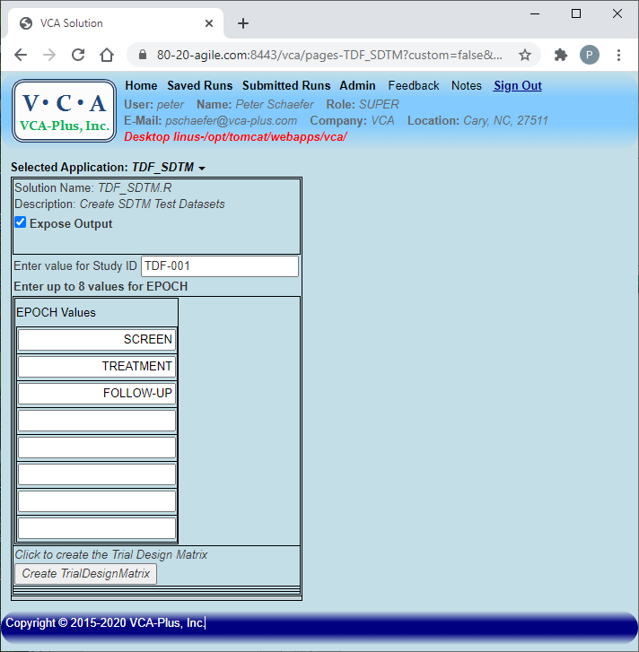
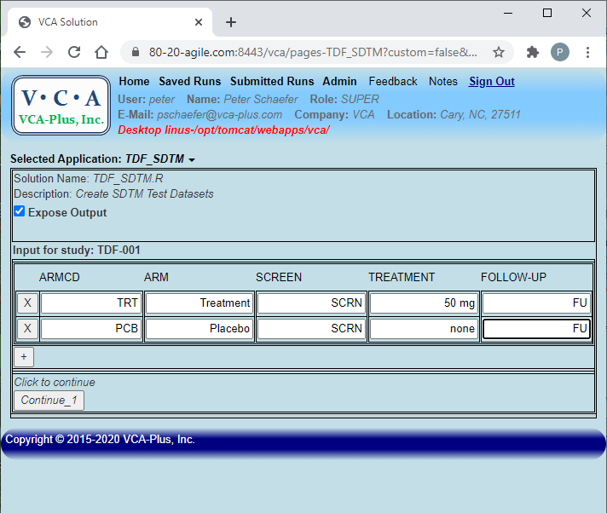
Start with entering the EPOCH values and define each ARM
System generates table, so that the user can enter details for each ARM;
When ready, “Continue”
User enters EPOCH values; Click on “Create” button

Slide 3
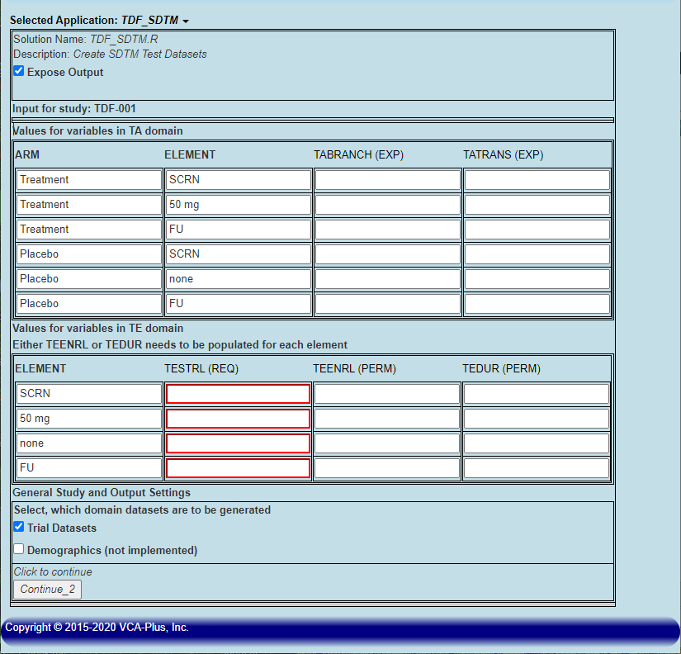
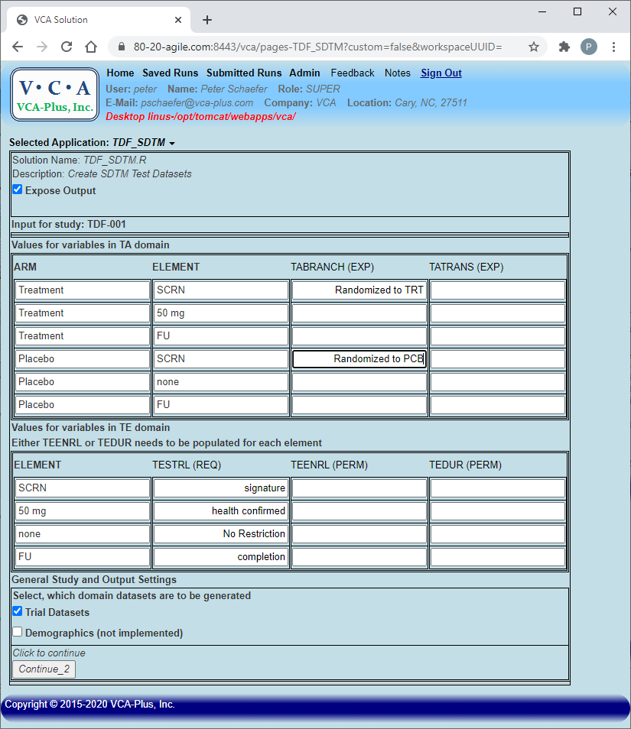
Enter details for each Element (as required in TA and TE)
System generates tables for Element details;
Required columns are highlighted
User entered the details;
When ready, “Continue”

Slide 4
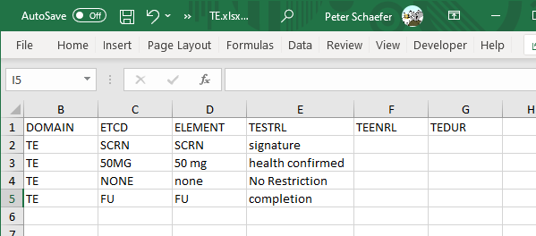
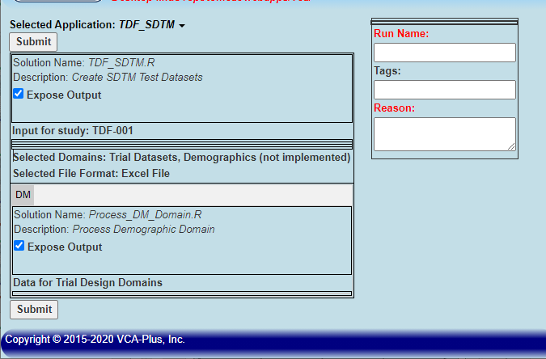
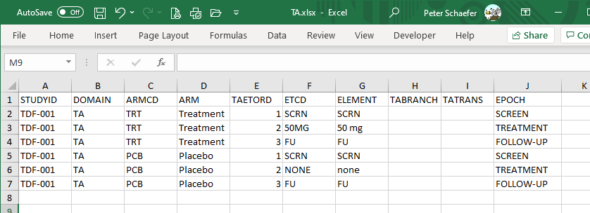
Final Step: Create Domain Datasets
If “Demographics” is checked, a new (empty) Tab is already created
When ready, “Submit” and the system will create the requested Domain datasets

